Slide 1


Analysis of Hotel Aggregator Listings using Tableau
Internship Project Presentation
Presenter: Anagha P

Slide 2

Dataset Description
Key Dataset Attributes:
Provides an overview of key attributes such as id, listing_url, scrape_id, etc.
Mentions the variety of information captured including hosts, location, property type, pricing, availability, reviews, etc.

Slide 3
Problem Statement
Objective: Analyze a dataset of hotel aggregator listings using Tableau to derive actionable insights for improving listing quality and competitiveness.
Key Points:
Analyze various attributes related to listings, hosts, reviews, and availability.
Create comprehensive visualizations to identify trends, patterns, and factors influencing listing performance.

Slide 4
Project Objectives
Objectives Overview:
Geographical Insights
Pricing and Availability Analysis
Host Performance
Review Scores and Guest Satisfaction
Property Type and Room Analysis

Slide 5
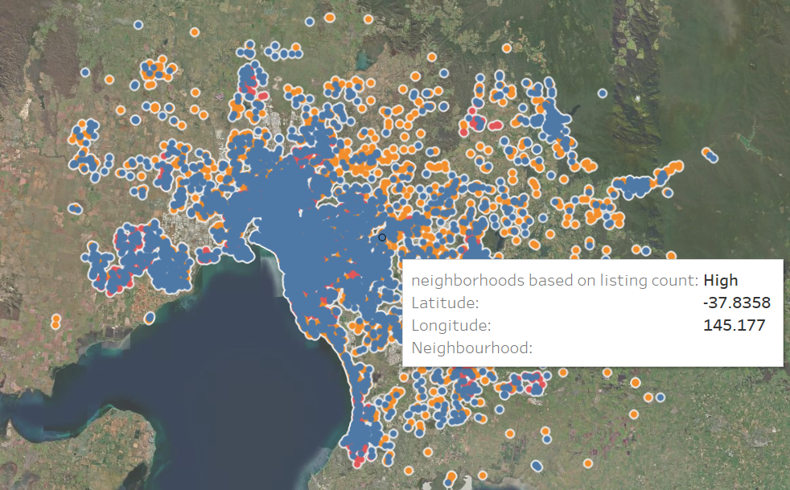
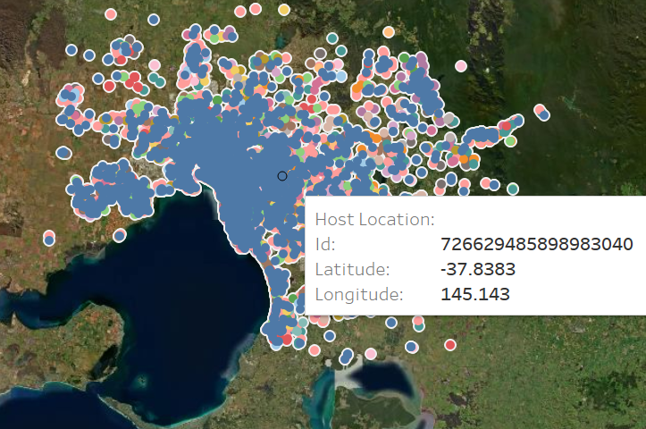
Objective 1: Geographical Insights
Visualize the distribution of listings on a map to identify popular neighborhoods.
Explore the geographical concentration of listings and host locations.

Slide 6
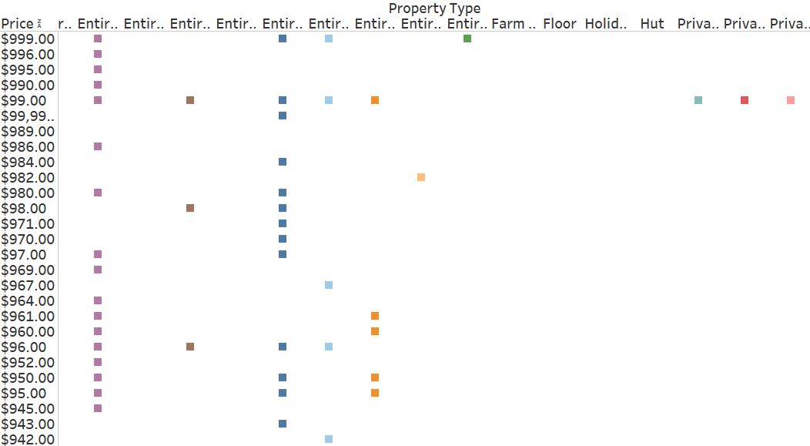
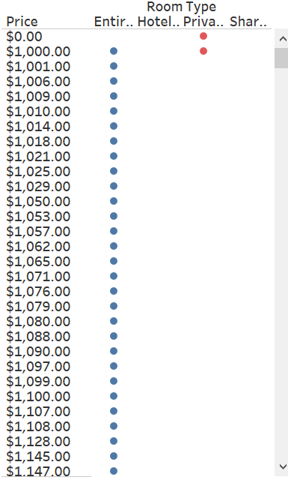
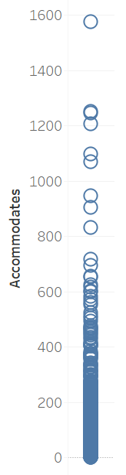
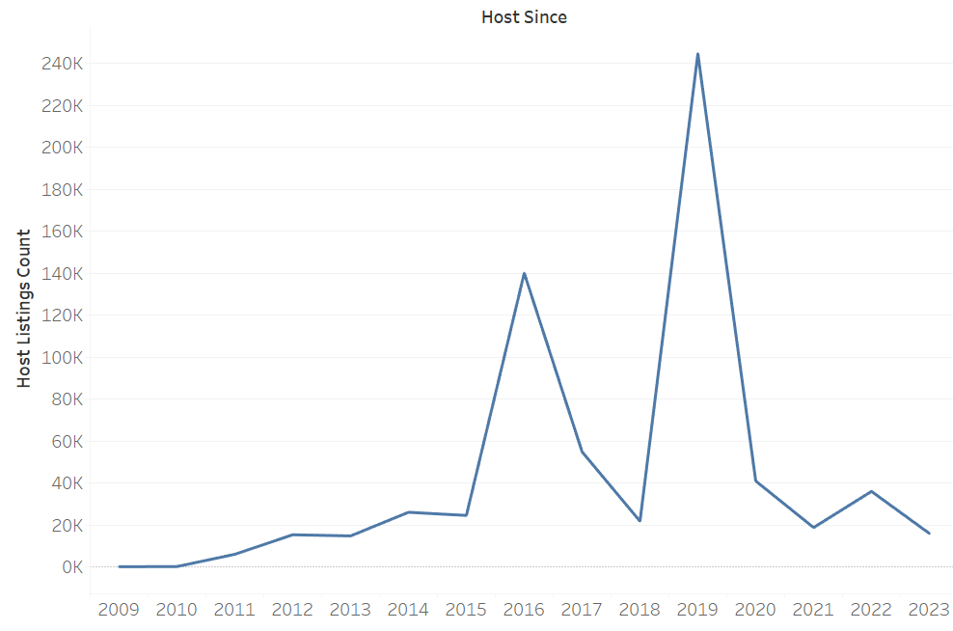
Objective 2: Pricing and Availability Analysis
Analyze pricing trends based on property types, room types, and accommodation capacity.
Investigate the availability of listings over time and identify peak periods.

Slide 7
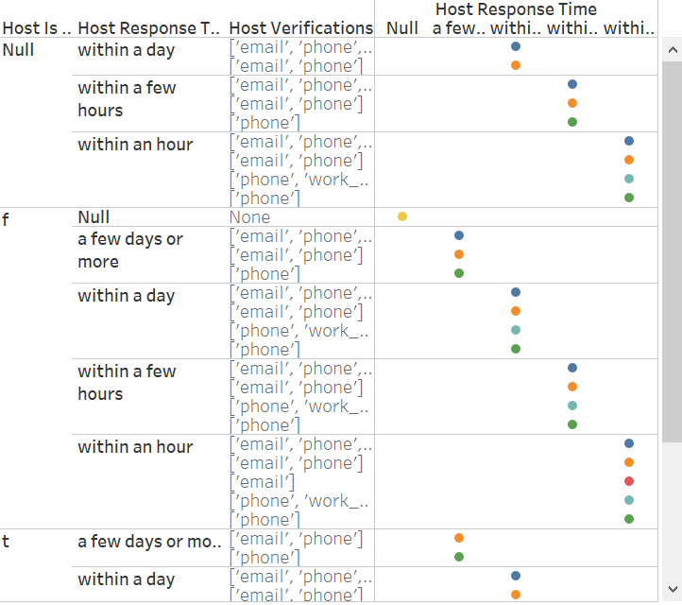
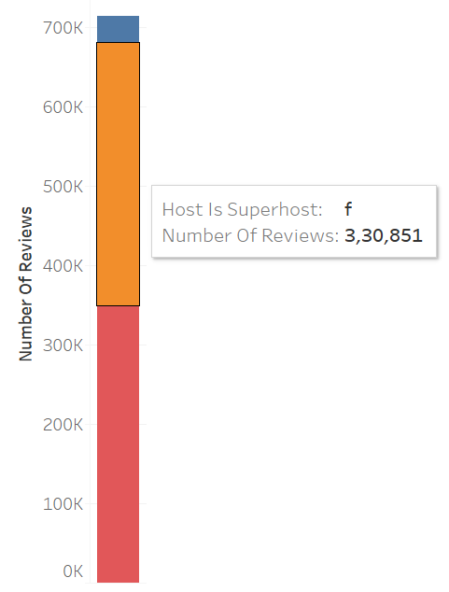
Objective 3: Host Performance
Evaluate host characteristics, including superhost status, response times, and verification methods.
Explore correlations between host attributes and listing performance.

Slide 8
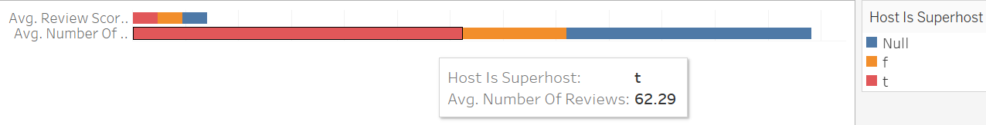
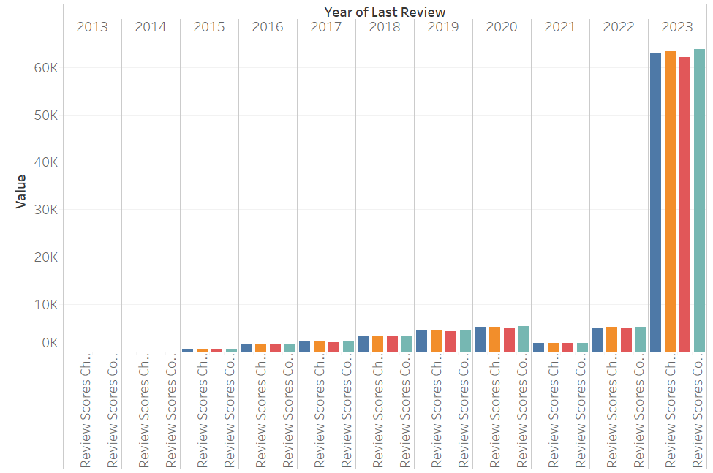
Objective 4: Review Scores and Guest Satisfaction
Examine review scores and their impact on overall listing performance.
Identify areas for improvement based on specific review categories.

Slide 9
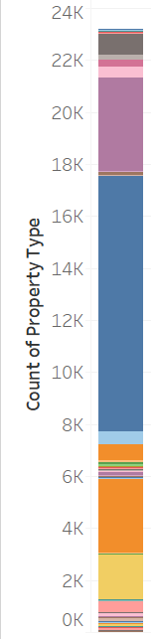
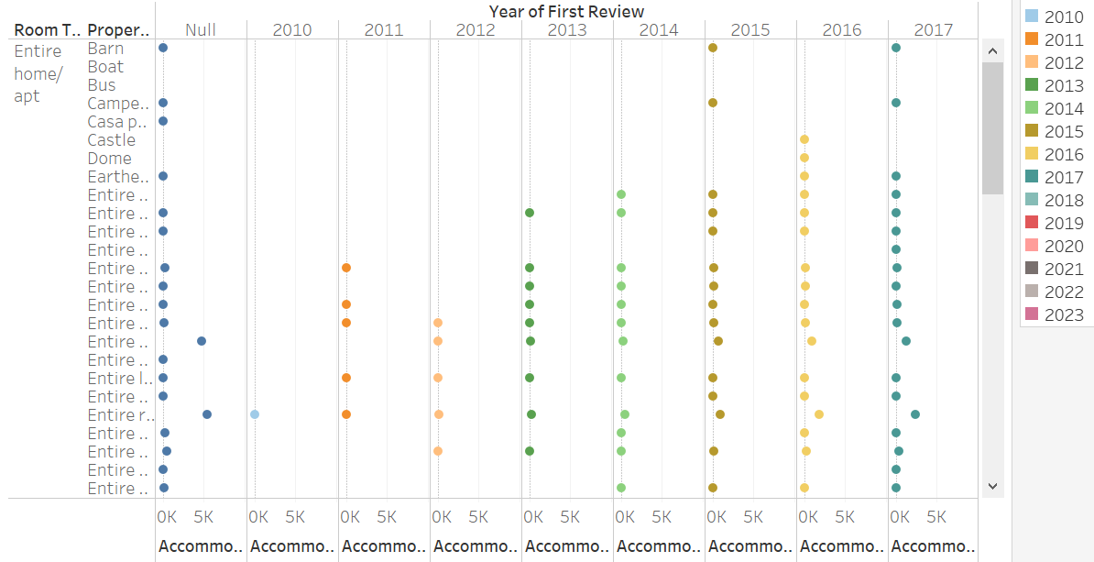
Objective 5: Property Type and Room Analysis
Analyse the distribution of property types and room types.
Explore trends in the popularity of specific accommodation setups.

Slide 10
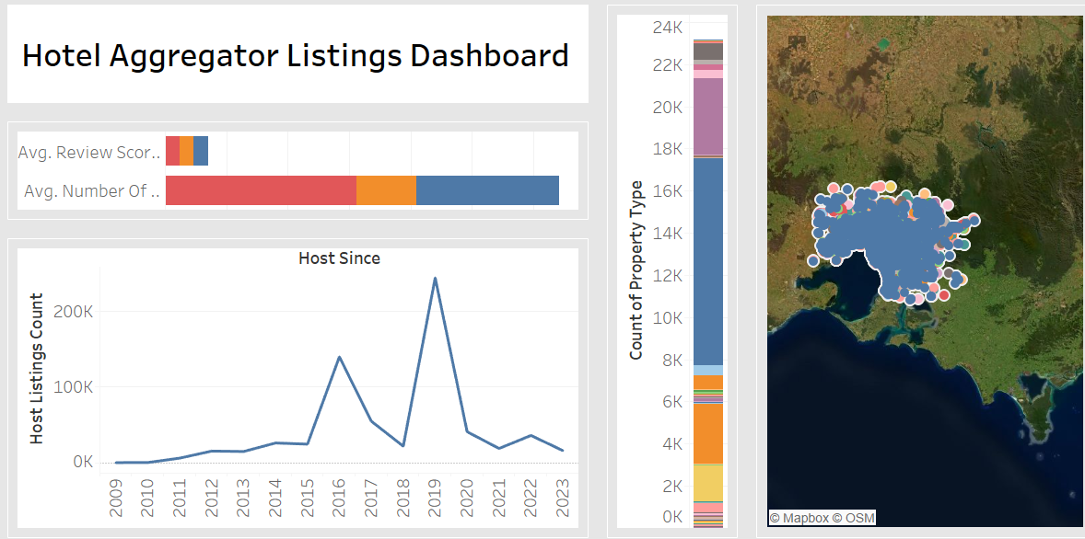
Dashboard
Interactive Tableau dashboards illustrating geographical distribution, pricing trends, host characteristics, and review scores.
Reports on availability patterns, property and room preferences, and factors influencing guest satisfaction.
Recommendations for hosts and the aggregator platform based on the analysis.

Slide 11
Conclusion
Our internship project focused on analyzing hotel aggregator listings using Tableau.
We delved into various aspects such as geographical insights, pricing, host performance, review scores, and property analysis.
Through interactive a Tableau dashboards, we gained valuable insights into trends, patterns, and factors influencing listing performance.
Our findings provide actionable recommendations for hosts and the aggregator platform to enhance the overall quality and competitiveness of listings.

Slide 12

Thanks
Do you have any questions?

